Slide 1
INTERNET BANKING
Project Guide: Anil Kumar Pinnaka
Team: Abhishek Simharaju(team leader)
Phani Rahul Pedduri

Slide 2
INTRODUCTION:
MAIN OBJECTIVE : Computerizing bank operations.
Provides Banking solutions.
saves time , increases operational speed.
Interface between bank and customer.
Login facility for customers/administrator.
transactions are carried out smoothly.

Slide 3
Existing System:
Manual development.
Searching process is difficult.
Data consistency may be lost.
Record keeping is difficult.
No provision for data recovery.
Slow.

Slide 4
Proposed System:
simulated banking system.
Transaction history is maintained.
AUTO-DEBIT FEATURE: Pays EMI’s automatically.
SMALL CREDIT: Borrowing small amount of money .
Consistent data.

Slide 5
REQUIREMENTS:
Software Requirements:
Web Presentation: HTML, CSS
J2EE Web/Application Server: Tomcat 6.026
Database: Oracle 11g
Application: J2SE, J2EE
Browser: Any browser
Hardware Requirements:
Pentium processor : 233 MHZ or above
RAM Capacity : 512MB
Hard disk : 40GB
Internet connection : 256 Kbps or higher

Slide 6
Basic Modules:
Client Module
Administrator Module

Slide 7
1.Client Module:
Money Transfer
Add and view auto debits
Apply for credit(if not applied)
Change security details
Request admin to change Account Details
View Transaction History
View Credit History

Slide 8
2.Administrator module:
Requests from client:
        Withdraws
        Deposits
        Edit client’s details
Creating accounts
Enabling/Disabling small credit
All the capabilities of a client.

Slide 9
Architecture:
browser
controller
database
Browser
Application/
model
view
Web Server

Slide 10
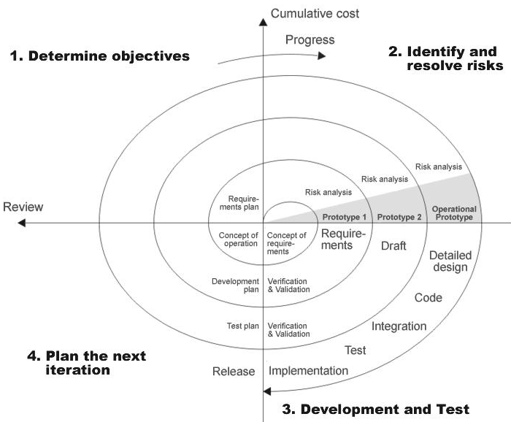
SDLC METHODOLOGIES:

Slide 11
Use Case Diagrams:

Slide 12
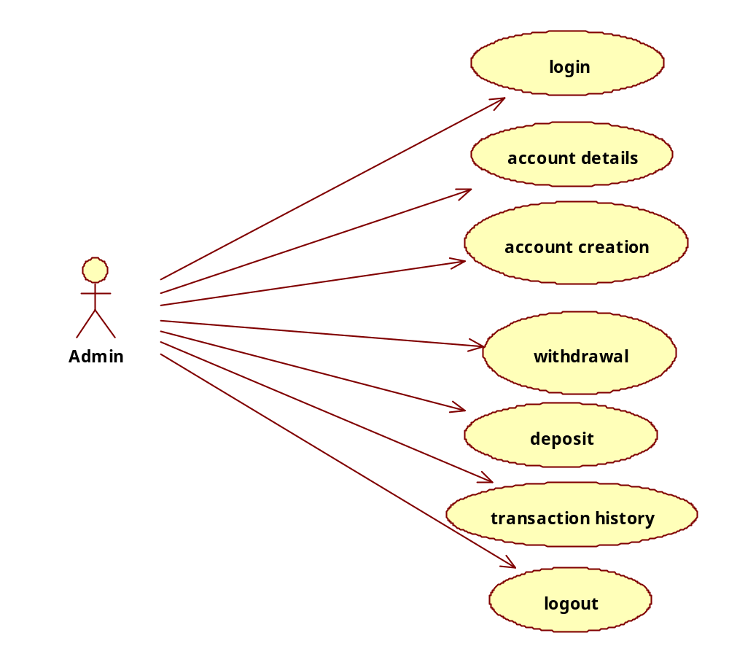
Use case Diagram for Admin:

Slide 13
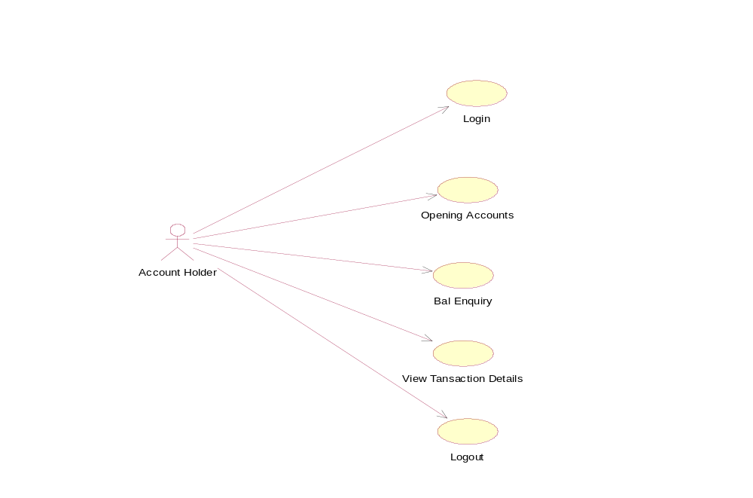
Use case Diagram for Account Holder(client):

Slide 14
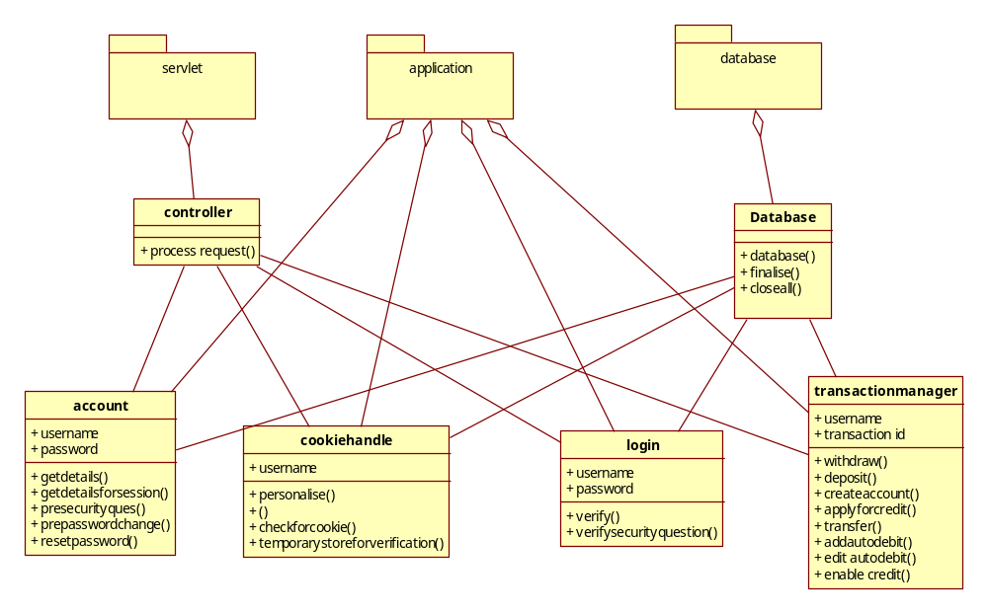
Class Diagram:

Slide 15
Sequence Diagrams:

Slide 16
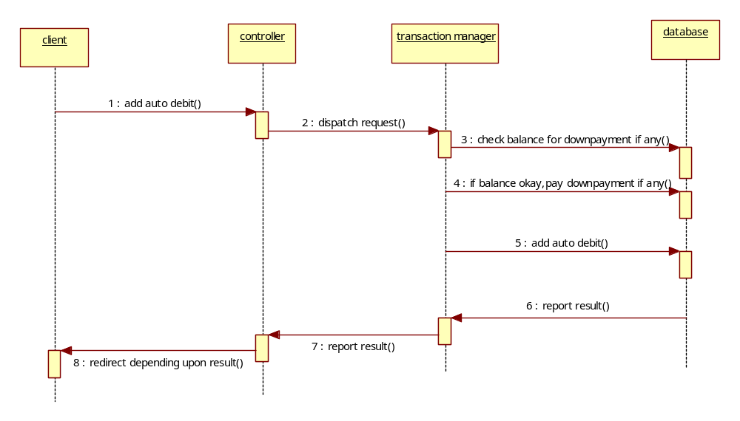
Add auto-debit:

Slide 17
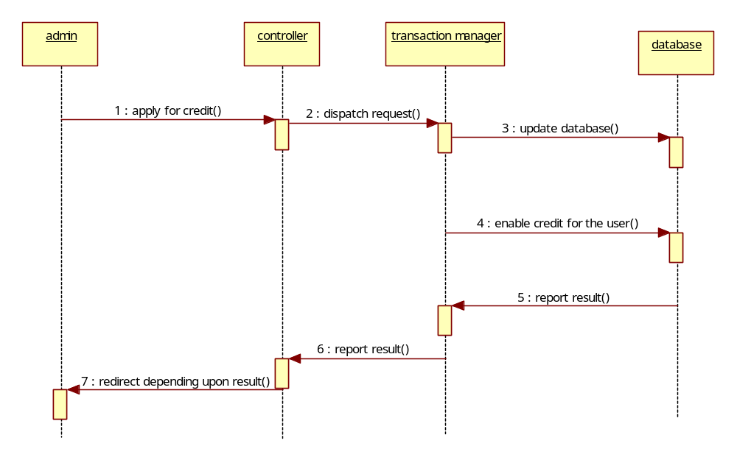
Apply for credit:

Slide 18
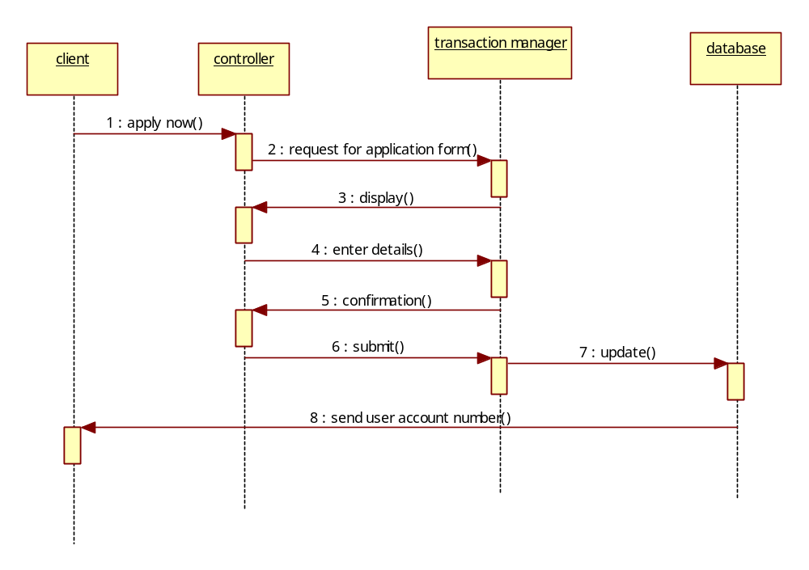
Apply now:

Slide 19
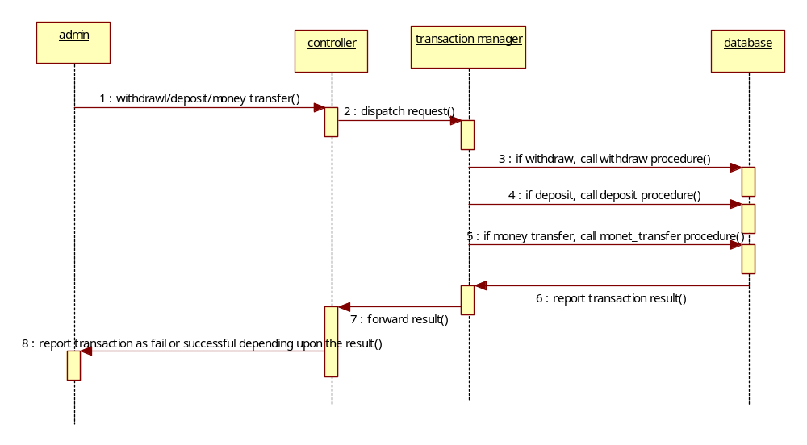
Transaction:

Slide 20
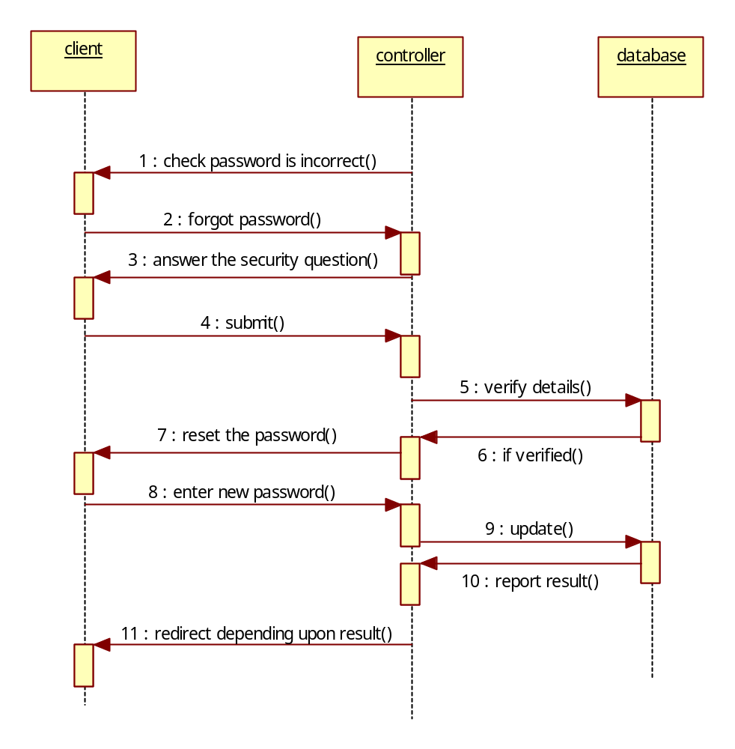
Forget password:

Slide 21
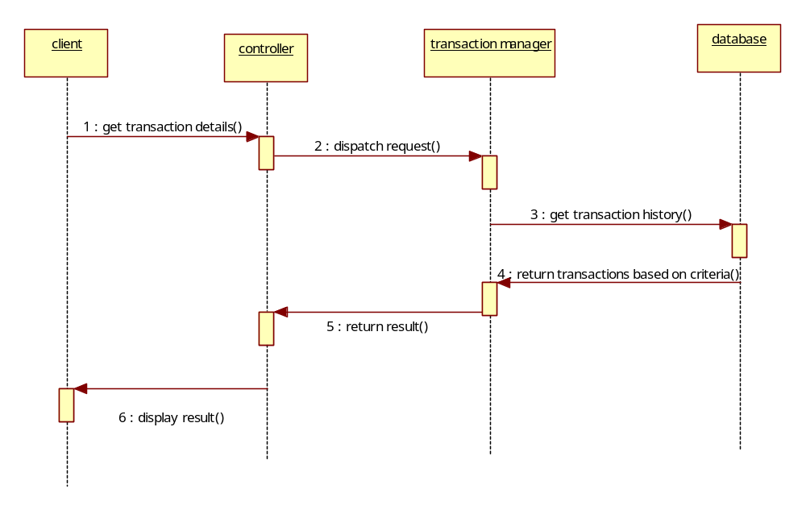
Transaction history:

Slide 22
screenshots:

Slide 23
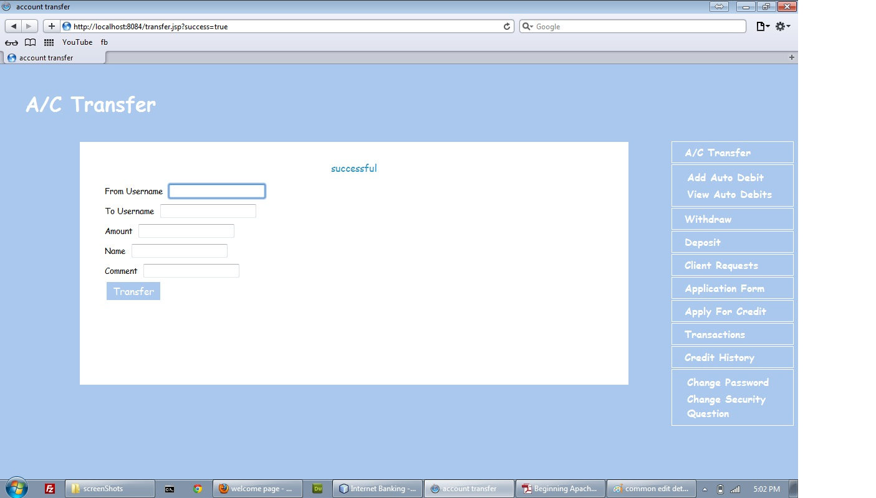
Money transfer successful(admin):

Slide 24
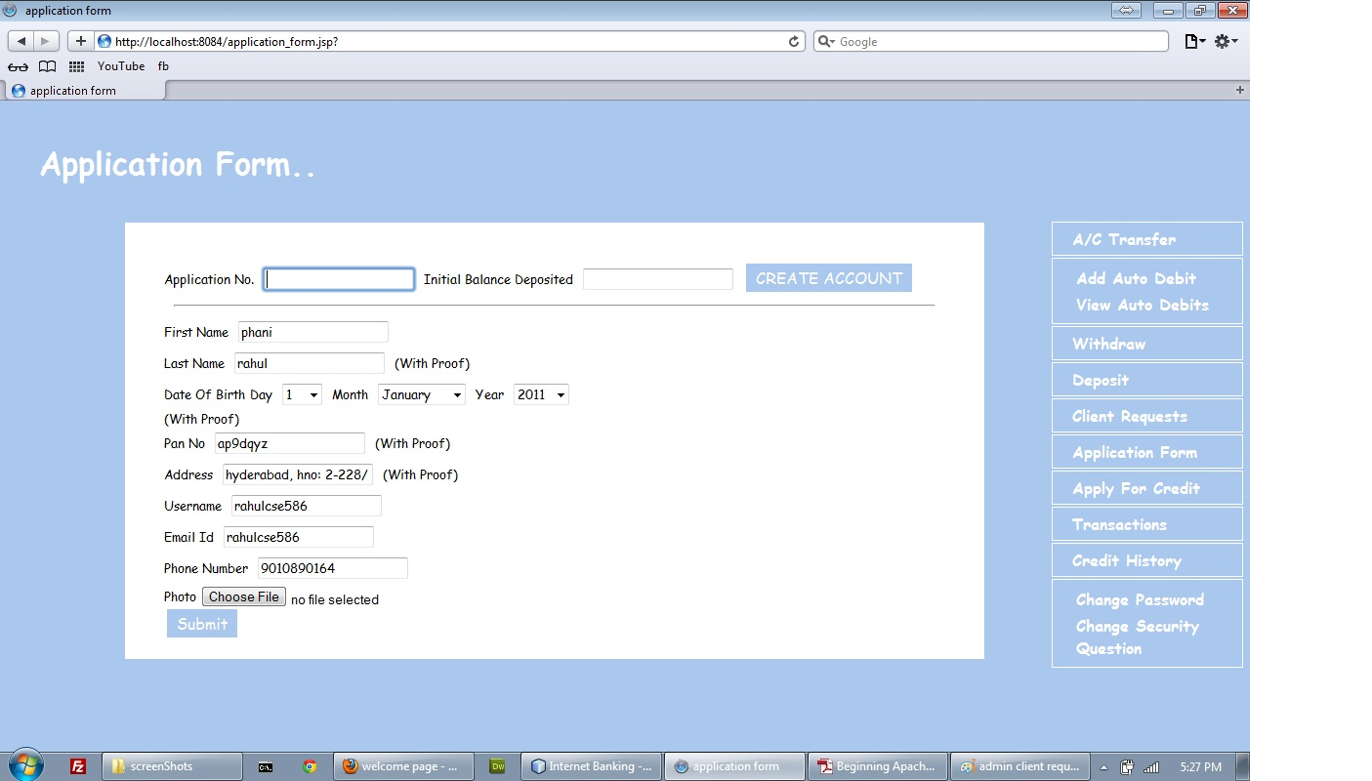
Application form(admin):

Slide 25
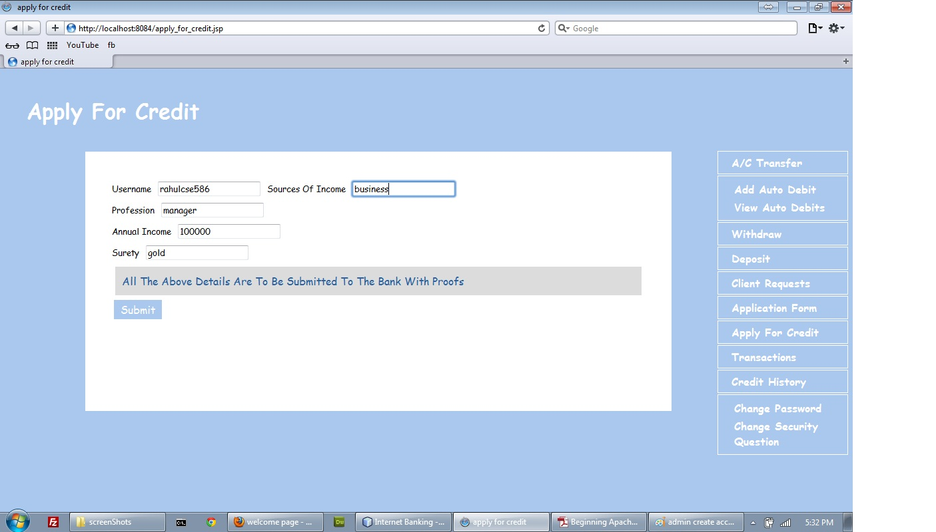
Apply for credit(admin):

Slide 26
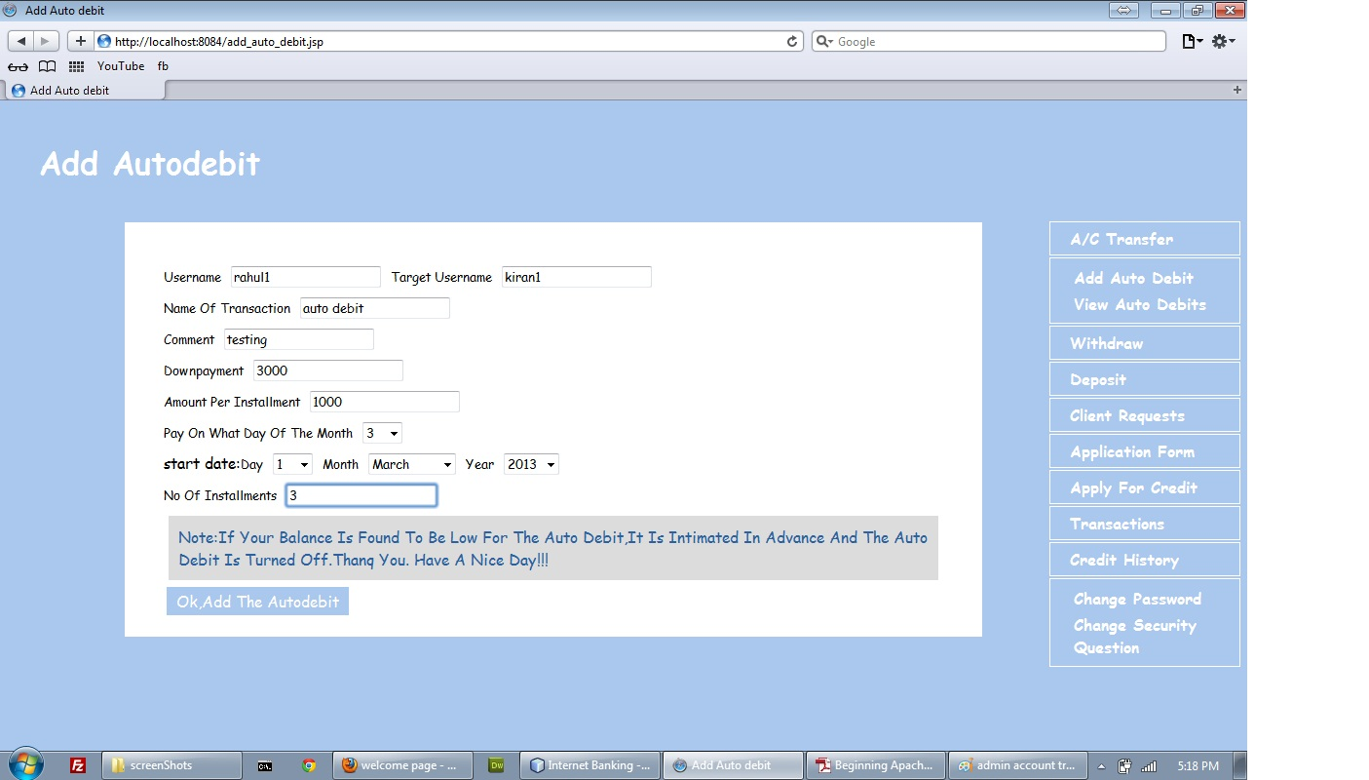
Add auto debit(admin):

Slide 27
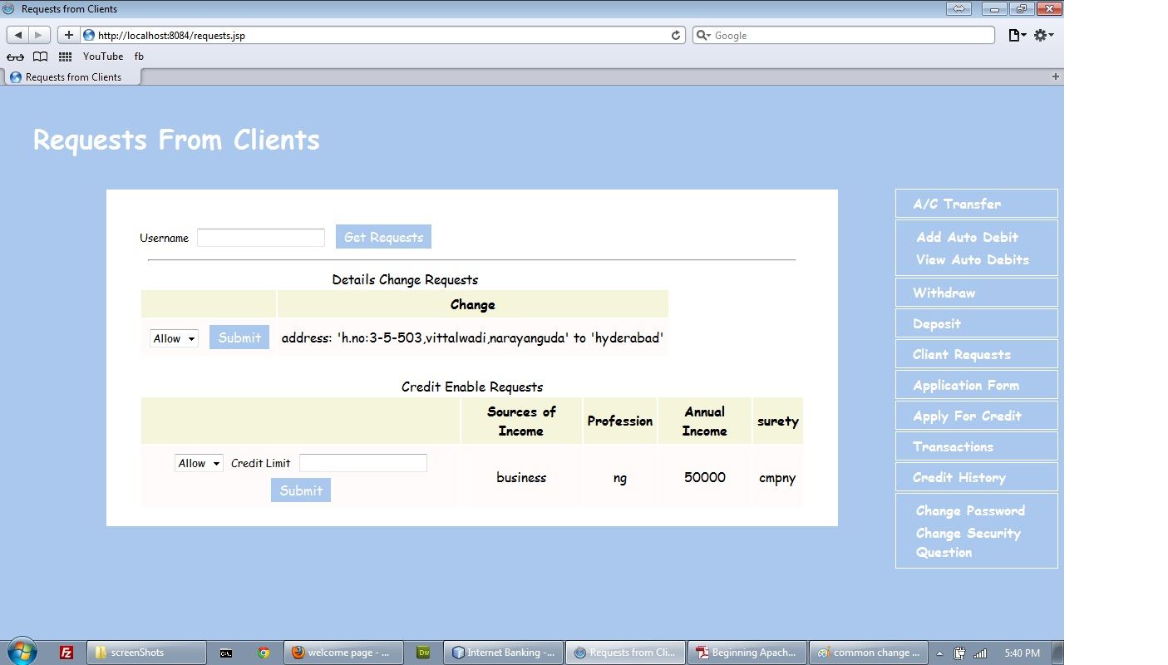
Requests from clients(admin):

Slide 28
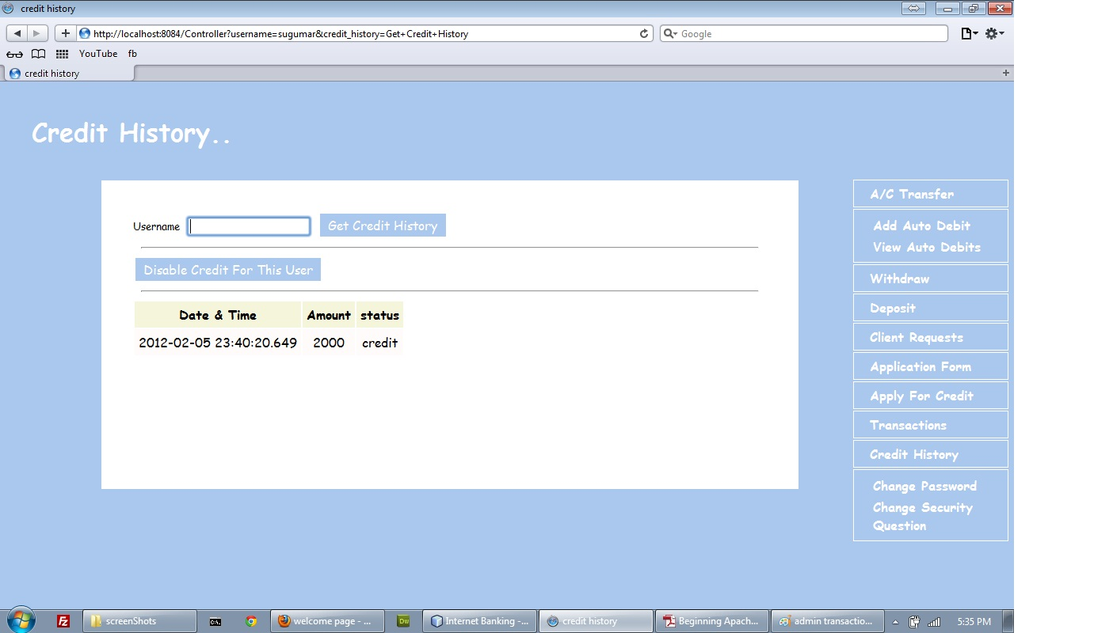
Credit history(admin):

Slide 29
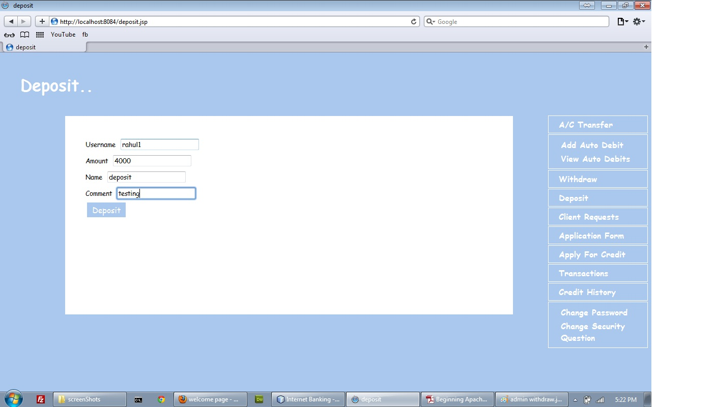
Deposit(admin):

Slide 30
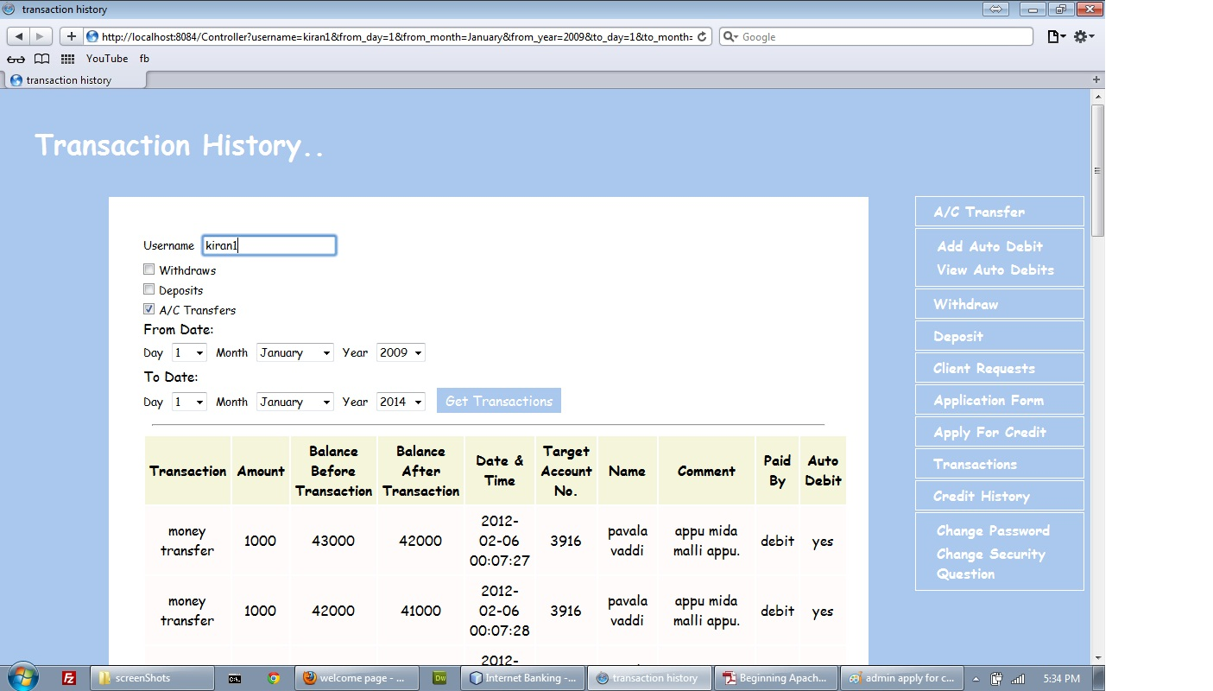
Transaction history(admin):

Slide 31
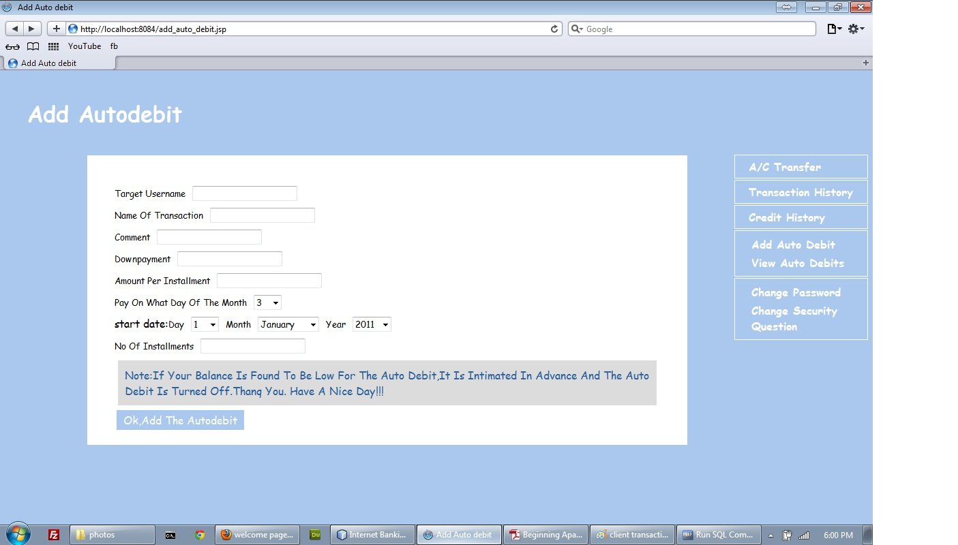
Add auto debit(client):

Slide 32
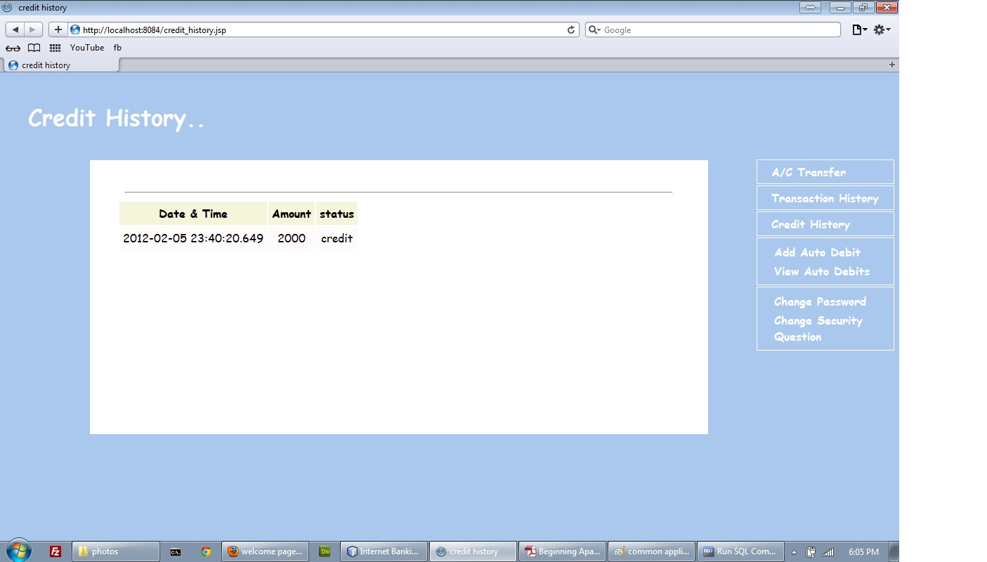
Credit history(client):

Slide 33
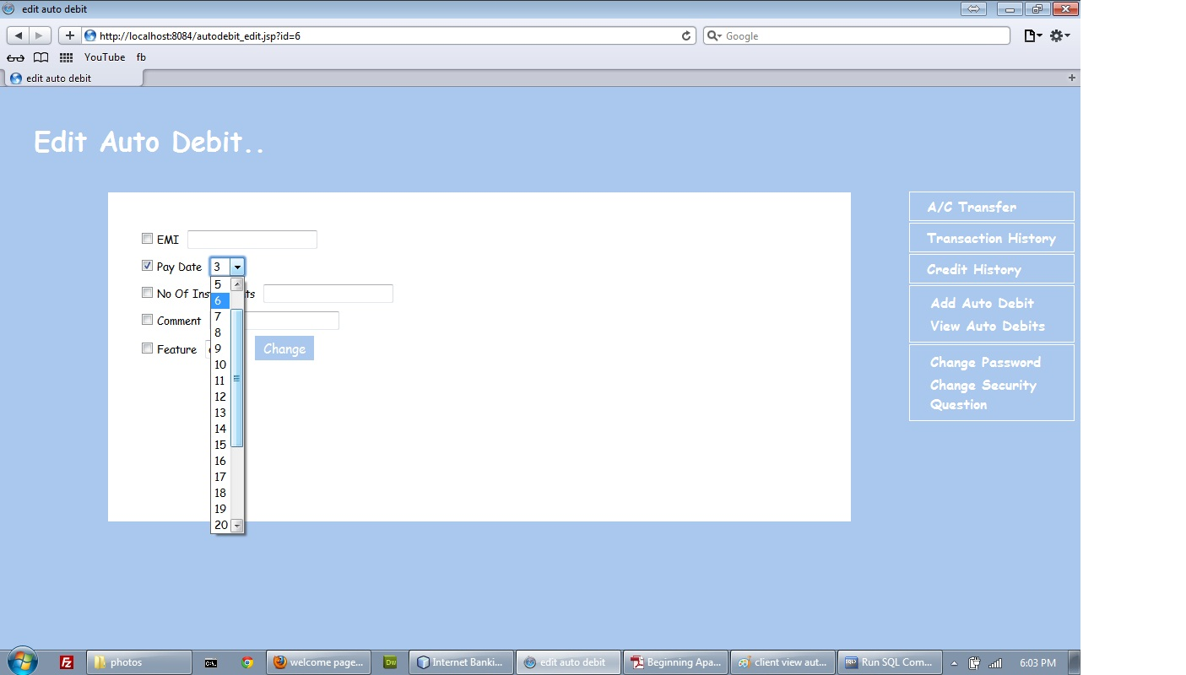
Edit autodebit(client):

Slide 34
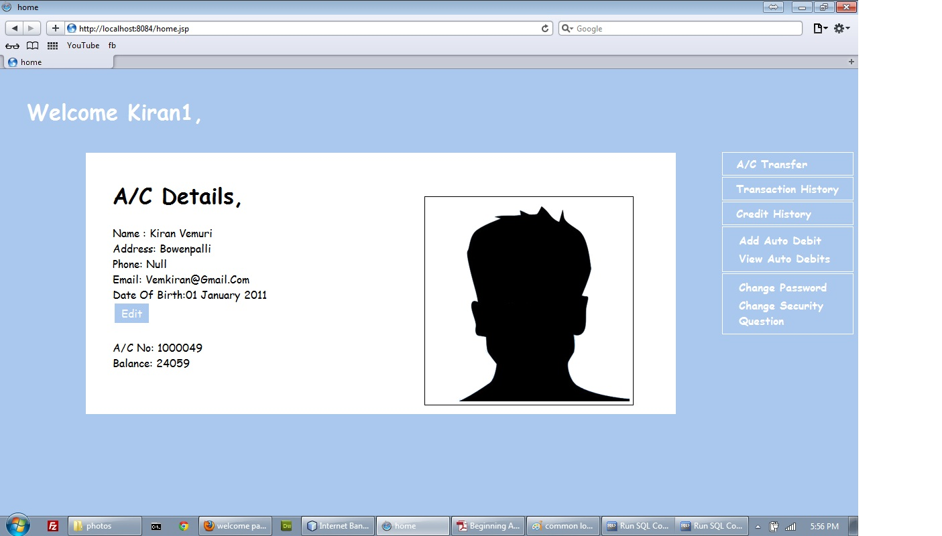
User home page(client):

Slide 35
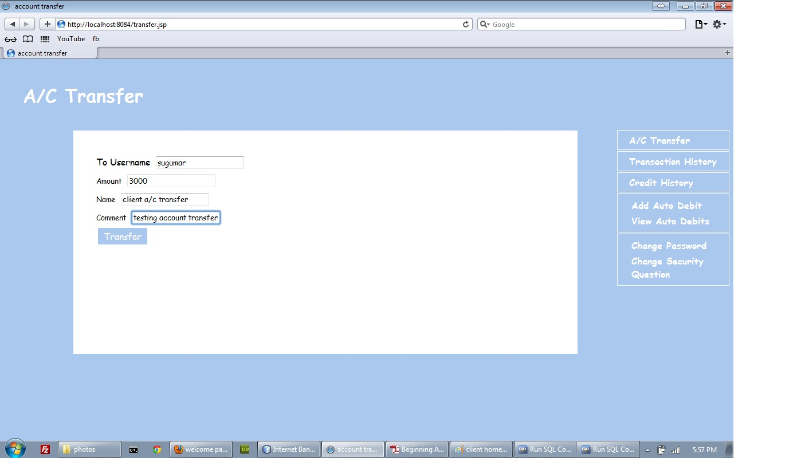
Money transfer(client):

Slide 36
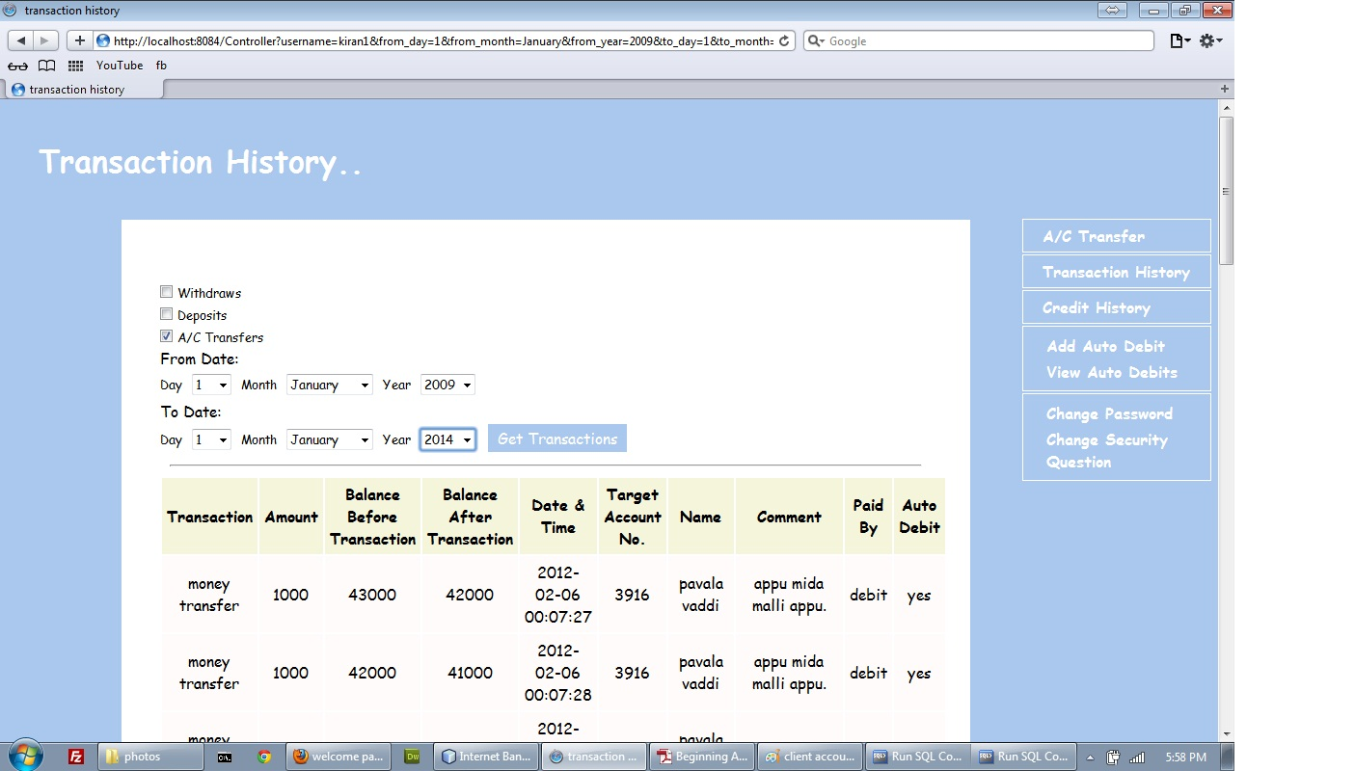
Transaction history(client):

Slide 37
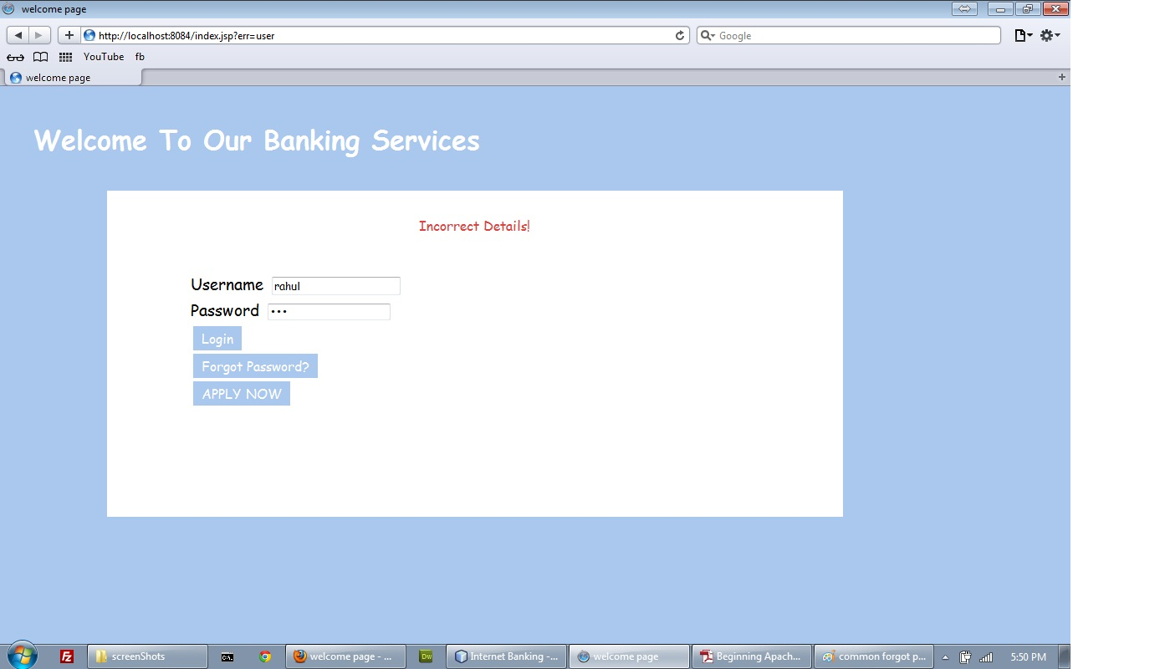
Login unsuccessful:

Slide 38
Conclusion:
  Easy retrieval of information.
  Fast finding of information requested.
  User friendly screens to enter the data.

Slide 39

Submitted by:
S.Abhishek(08N31A05A5),
P.Phani Rahul(08N31A0586)
Internal guide,
Anil Pinnaka

